Slide 1
Preventing Bar Closure
Group-15: Max Schleck, Shravan Kaul, Jiayang Wang

Slide 2
Introduction
Yelp’s quarterly economic status report labeled the restaurants as one of the top two failing service industries.
Within the restaurant category, bars continually rank as the restaurant type with the highest rate of closure consistently in this post Covid landscape.
Research reasons why bars are continuing to fail at a higher rate.

Slide 3
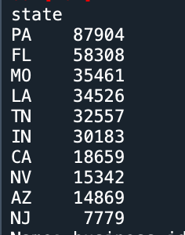
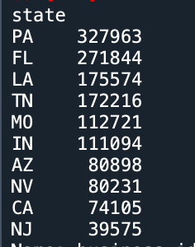
Data Cleaning
First we preprocessed all the business and reviews json files to scrape the information.
We chose Pennsylvania as it had the most number of businesses in both open and closed categories and wanted to stick to one demographic for best results to find reasons of bar closure in a region.
CLOSED OPEN

Slide 4
Text Cleaning
Tokenization, Lemmatization and Removal of Stop Words.
Language detection to English
Modified Stopwords list for added safety for text classification model to remove unnecessary words not related to bar aspects.
Profanity filter words to avoid skewing of review data.

Slide 5
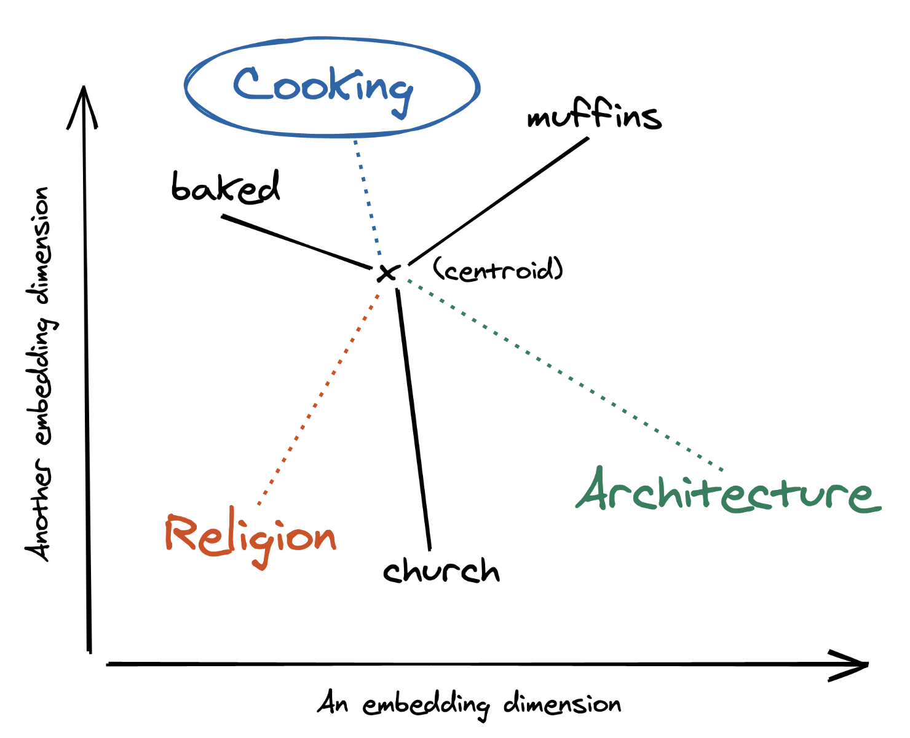
Language Processing and Sentiment Analysis
Defining aspect labels after EDA : Ambience, Food, Drinks, Price and Service Creating word embedding from one of models like BERT, ELMO, Glove and Word2vec for reviews as well as aspect labels.
Using centroid based distance calculation to classify reviews into aspects (NearestNeighnors)
Choosing Sentiment analysis model between TextBlob, Vader & DistilBERT.

Slide 6
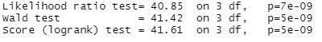
Resulting Hazards Model:
Surv(time,is_open)~Drink + Ambience + Price + strata(Service)
 | Hazard Ratio:
Price | 1.19
Ambience | 1.24
Drinks | 1.13

Slide 7
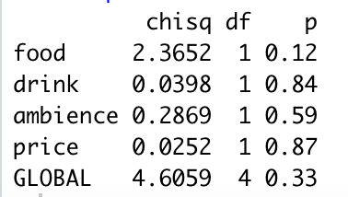
Assumption Checking
Proportional Hazards
The CPH model requires the relative hazard (or risk of closure) to be constant over time and as our other predictors vary.
This assumption is checked by referencing the scaled Schoenfeld residuals correlation with time.
Generating these correlation coefficients (p values in the table to the left) shows that none of our predictors are correlated at the 10% significance level.
This assumption was met.

Slide 8
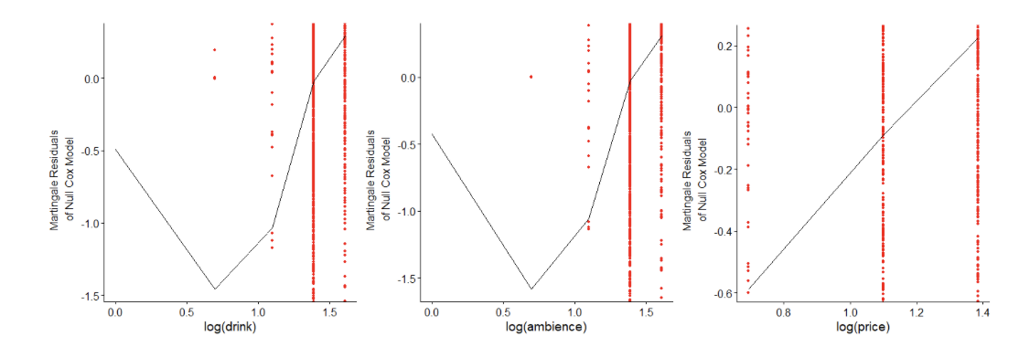
Assumption Checking
Linearity of log(Hazard) and Predictors
The CPH model additionally requires there to be a roughly linear relationship between the log of our hazard and our predictors.

Slide 9
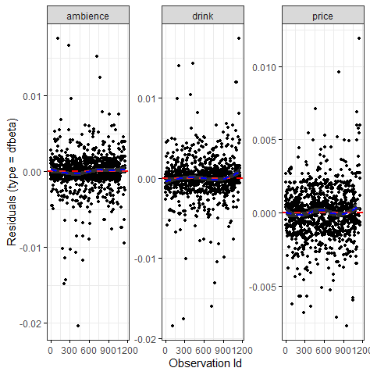
Assumption Checking
Influential Points
we looked to remove potential outliers impacting our model.
This is checked visually by reviewing a dfbeta plot. This plot represents the changes to the regression coefficients that occur when said point is removed.
Looking at the dfBeta plots to the right we see that all points are within this threshold meaning we do not need to do any outlier removal at this point with our data.

Slide 10

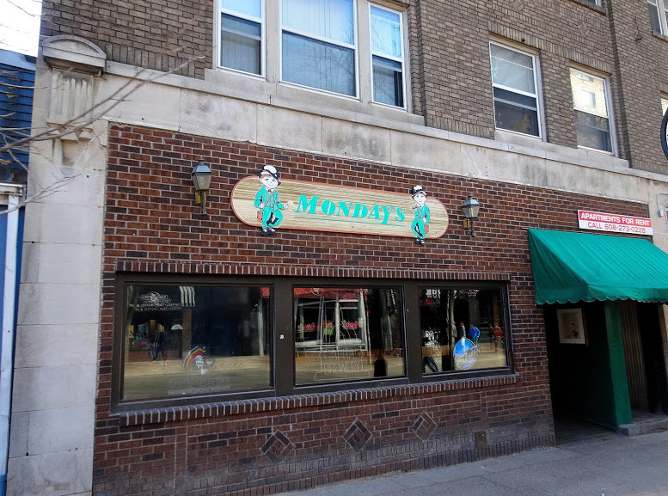
Recommendations:
The Monday’s Method!
Focus:
Improving culture
Happy hour/Drink Deal opportunities
Seasonal Drink Menus
Ignore:
Food

Slide 11
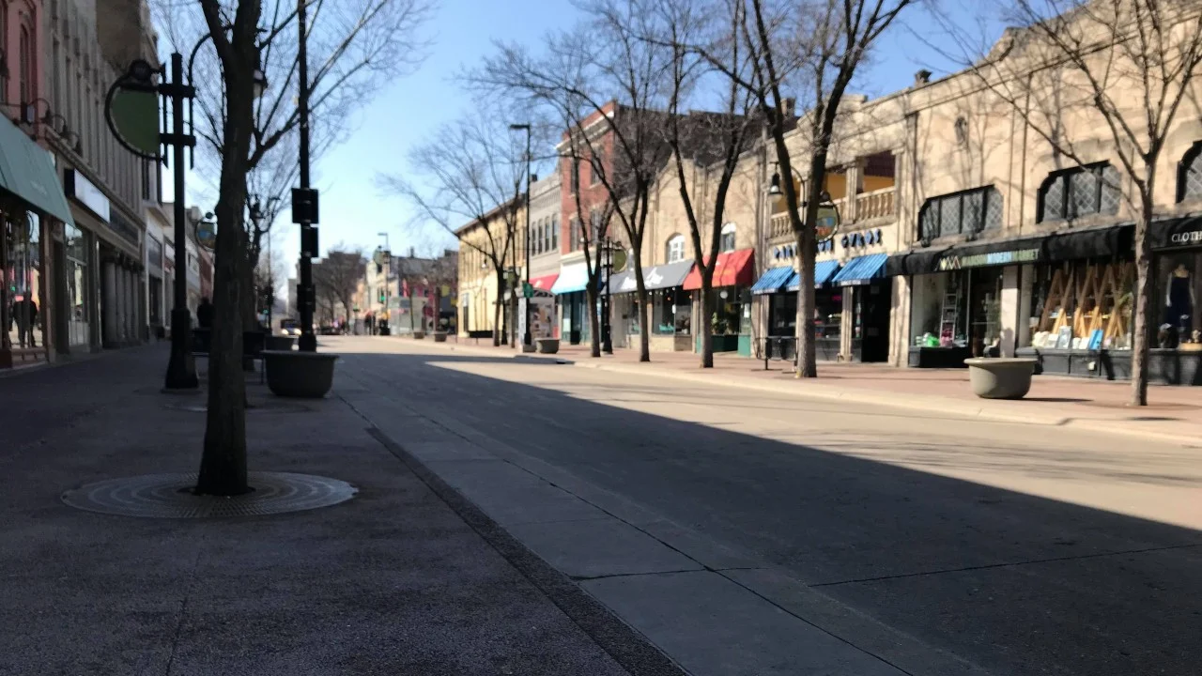
Future Improvements
Post Covid world calculations:
Give the data 2 years to collect
Broaden state scope
Multiprocessing NLPs
Statestreet on a Saturday at 2pm during Isolation

